Slide 1

Student Details
NAME : P . SANTHOSH
ADMISSION NO : AP22110011276
INSTITUTE : SRM UNIVERSITY
SKILLBUILD : santhosh_palem@srmap.edu.in
DOMAIN : CYBER SECURITY
DATE OF JOINING : 03-06-2024
DATE OF ENDING: 25-07-2024

Slide 2
Project Title: “Image-Based Steganography: Enhancing Security through Hidden Messages”
Problem Statement: With the exponential growth of digital communication, ensuring the confidentiality and integrity of sensitive information has become a paramount concern. Traditional encryption methods, while effective, are often targeted by cybercriminals and can raise suspicion when intercepted. Steganography, the practice of concealing information within other non-secret data, offers an additional layer of security by hiding the very existence of the message.
Image Steganography, a branch of steganography, leverages digital images as the medium for embedding hidden data. Despite its potential, image steganography faces several challenges,
.

Slide 3
AGENDA
Our steganography project aims to ensure secure data transmission by embedding and extracting hidden messages within digital images using the Least Significant Bit (LSB) technique and XOR encryption. Key objectives include maintaining the invisibility and security of hidden messages, simplifying implementation through the use of standard image formats, and customizing algorithms and user interfaces for enhanced performance and usability. The project emphasizes concealing messages without noticeable alterations, using XOR encryption for additional data protection, and providing practical code examples to demonstrate the embedding and extraction processes. Detailed modeling steps and practical implementation showcase the project's thorough approach to secure communication.

Slide 4
PROJECT OVERVIEW
Objectives: Embedding and extracting hidden messages within digital images using the Least Significant Bit (LSB) technique combined with XOR encryption.
Methodology:
LSB Technique: Modifying the least significant bits of pixel values to embed secret data, ensuring minimal visual changes to the host image.
XOR Encryption: Enhancing security by encrypting data before embedding, making it difficult for unauthorized users to decipher the hidden message.
Applications:
Personal privacy and secure data storage.
Stealthy communication in restrictive environments.
Secure transmission of sensitive information.
Ensuring confidential communication channels.
Safeguarding anonymity and protecting sources.

Slide 5
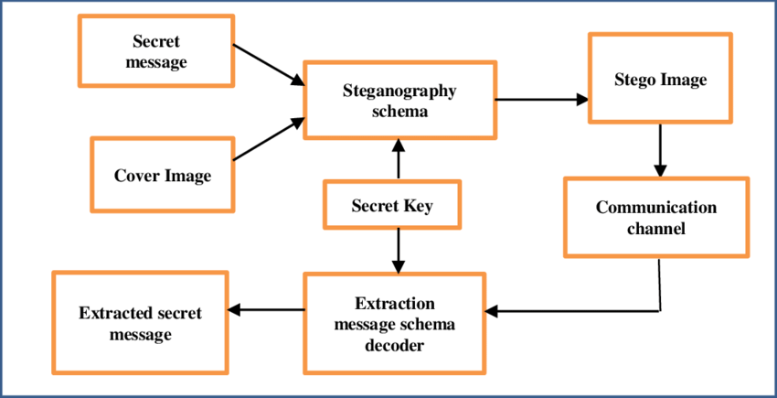
Project overview

Slide 6
WHO ARE THE END USERS of this project?
Cybersecurity Professionals: To protect sensitive data and communication from cyber threats.
Government Agencies: For secure communication and transmission of confidential information.
Journalists: To protect the identity of their sources and ensure secure communication.
Activists: For secure communication in regions with restricted freedom of speech.
Corporations: To safeguard intellectual property and internal communications.
Law Enforcement: For secure transmission of sensitive information during investigations.
Individuals: For personal privacy and secure data storage.
Military Personnel: For covert communication and secure transmission of classified information.
Healthcare Providers: To protect patient data and ensure confidential communication.
Financial Institutions: For secure transmission of financial data and communications.

Slide 7
YOUR SOLUTION AND ITS VALUE PROPOSITION
SOLUTION:
Our steganography project provides a robust and secure method for embedding and extracting hidden messages within digital images. By combining the Least Significant Bit (LSB) technique with XOR encryption, we ensure that hidden data remains undetectable and secure from unauthorized access.
Key Features:
LSB Technique: Embeds secret data by modifying the least significant bits of pixel values, maintaining the original appearance of the host image.
XOR Encryption: Encrypts data before embedding to enhance security, making it difficult for unauthorized users to decipher hidden messages.
Implementation: Features a user-friendly interface, utilizes common image formats for compatibility, and offers customizable algorithms to optimize security and performance.
VALUE PROPOSITION:
Enhanced Security: Adds encryption and concealment to reduce data interception risks.
Confidential Communication: Secure transmission for sensitive information, ideal for journalists and activists.
Privacy Protection: Safeguards personal data and prevents breaches.
Intellectual Property Protection: Embeds copyright info to protect against unauthorized use.
Covert Communication: Enables stealthy communication in sensitive environments.
Versatility: Applicable across various sectors and adaptable to different security needs.

Slide 8
How did you customize the project and make it your own
Advanced Encryption: Incorporated XOR-based encryption with a passcode, ensuring that embedded messages remain secure and are only retrievable with the correct passcode.
Enhanced Image Integration: Applied the Least Significant Bit (LSB) technique for precise embedding and extraction of encrypted messages, enhancing the overall security of the data.
Improved User Experience: Designed intuitive input prompts for specifying the image path, passcode, and message. Added user feedback on successful operations and automated the opening of the resulting encrypted image for convenience.
Optimized Performance: Fine-tuned the system to minimize alterations to image quality and safeguard the hidden message's integrity against potential image edits or manipulations.
Flexible Functionality: Included options for various image formats and passcode complexities to accommodate different user needs and security preferences.
Robust Error Handling: Implemented comprehensive error handling to manage incorrect inputs or failed operations, enhancing the reliability and user trust in the application.

Slide 9
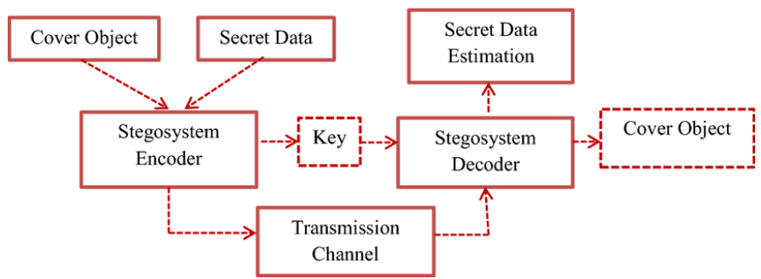
MODELLING
Input Handling:
Users provide the path to the image file, enter a passcode, and input the text they wish to hide.
Encryption Process:
Converts the input text into a sequence of ASCII codes.
Encrypts these ASCII codes by applying an XOR operation with characters from the passcode.
Embedding Process:
Integrates the encrypted text into the image using the Least Significant Bit (LSB) method.
Processes image pixels across all color channels (Red, Green, Blue) to embed the data.
Output Handling:
Saves the image with the embedded data in a new file.
Displays a confirmation message to the user and automatically opens the saved image for review.
Extraction Process:
User provides the passcode to access the hidden text.
Extracts the embedded text from the image and decrypts it using the XOR method with the same passcode.

Slide 10

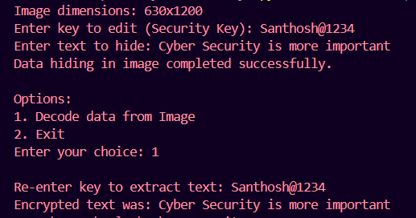
Results
Normal Image
Encrypted Image

Slide 11
links
Project Link : https://github.com/SanthoshPalem/Cyber-Security-Internship (press ctrl + left click to open the links)
IBM Skill Build Email ID : santhosh_palem@srmap.edu.in
LinkedIn : www.linkedin.com/in/santhosh-palem

